Slide 1
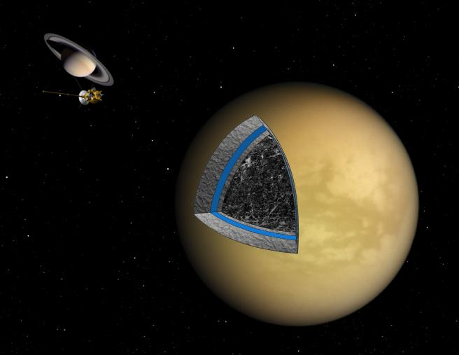
Thermal and compositional evolution of a three-layer Titan
?
Michael Bland and William McKinnon

Slide 2
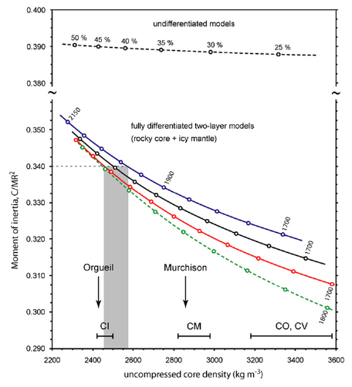
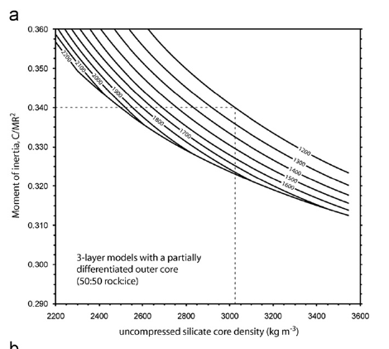
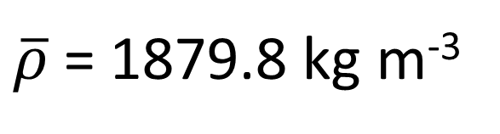
Constraints on Titan’s internal structure
C/MR² ≈ 0.34
Iess et al. 2010
$\overline{ρ}$ = 1879.8 kg m⁻³
Jacobson, 2006
Fortes, 2012

Slide 3

Two (of several) possible interior states
Ice
Ice
Can a partially differentiated Titan persist to the present day?
hydrated silicate
Mixed ice + rock
dehydrated silicate
silicate
Castillo-Rogez and Lunine 2010
This Work
Titan accretes rapidly
Titan accretes from low density material (2.75 g cm⁻³)
Titan must avoid complete dehydration (>30% ⁴⁰K is leached from the core)
Titan accretes slowly
Titan accretes from solar-like material (antigorite+sulfide+…; 3.0 g cm⁻³)
Titan must avoid further differentiation!

Slide 4
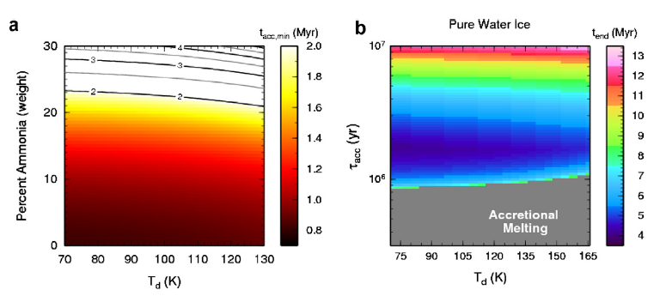
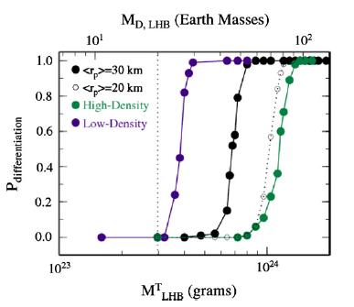
Can Titan form undifferentiated?
Titan can form undifferentiated
Titan survives the LHB undifferentiated
Barr et al. 2010

Slide 5

Can a partially differentiated Titan persist to the present day?
Approach: Develop a “simple” three layer 1D thermal model to test whether three-layer Titans avoid further differentiation over time.
Build on the heritage of Bland et al. 2008, 2009
Three layers: pure ice shell, mixed ice-rock shell, pure silicate core
Include both conduction and convection (calculate Ra and Ra_{c})
Parameterized convection of Solomatov and Moresi 2000.
Diffusion creep of ice and silicates
Mixed-layer viscosity increased by silicates (Friedson and Stevenson 1983)
Long-lived radiogenic heating in core and mixed layer (Kirk and Stevenson 1987)
Account for melting and refreezing in the pure ice and the mixed ice-rock layer
Melting of mixed ice-rock layer liberates silicate particulates: Differentiation!
Particulates release gravitational energy (included in energy budget)
Track the internal structure (e.g., density, pressure, moment of inertia)
Presently no ammonia or clathrate (or chemistry!)
Goal: Find three layer models that are thermally stable and match Titan’s mean density and current moment of inertia.

Slide 6
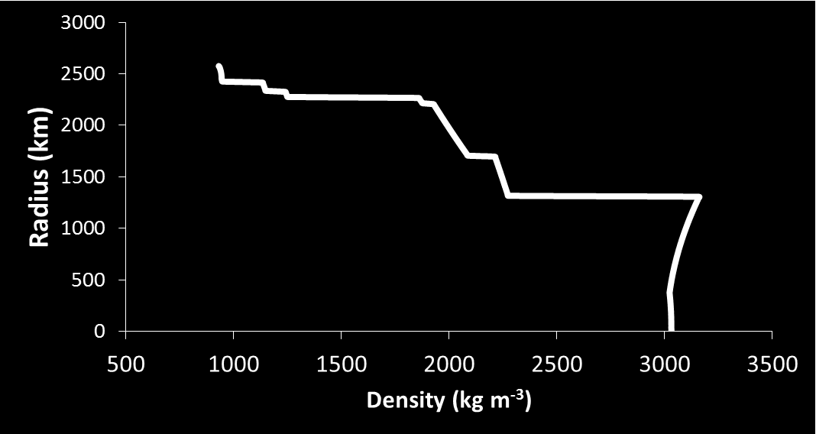
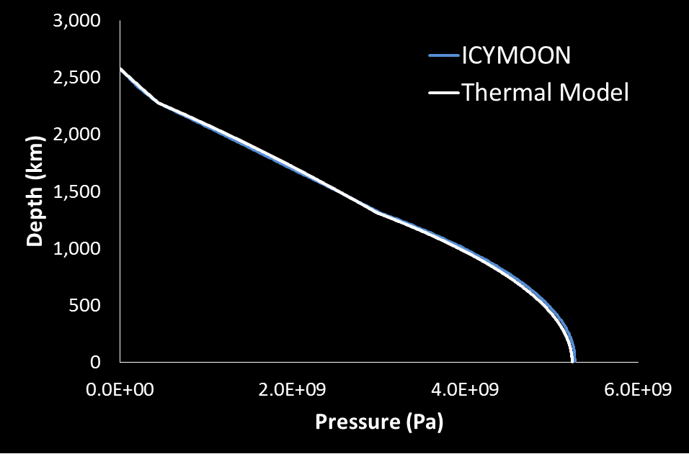
The Nominal Model
Ice I
2576 km
Ice III
Ice V
Ice V + rock
Ice
2275 km
Mixed Ice + Rock (2095 kg m⁻³)
Ice VI + rock
Ice VII + rock
1309 km
Rock (3066 kg m⁻³)
rock
Silicate Mass Fraction: 0.555
Mean density: 1879 kg m⁻³
C/MR² = 0.3415
(C/MR² = 0.344 from thermal model)

Slide 7
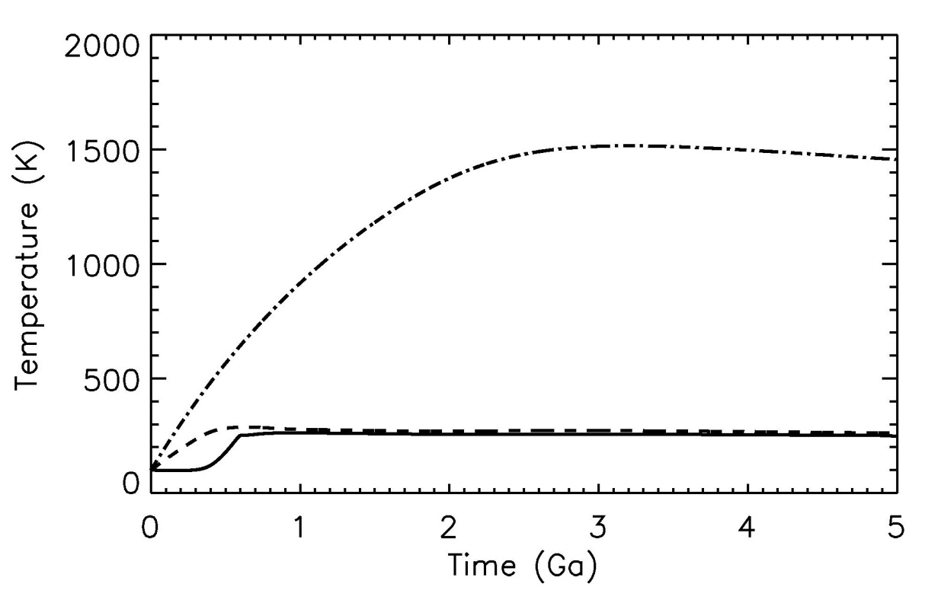
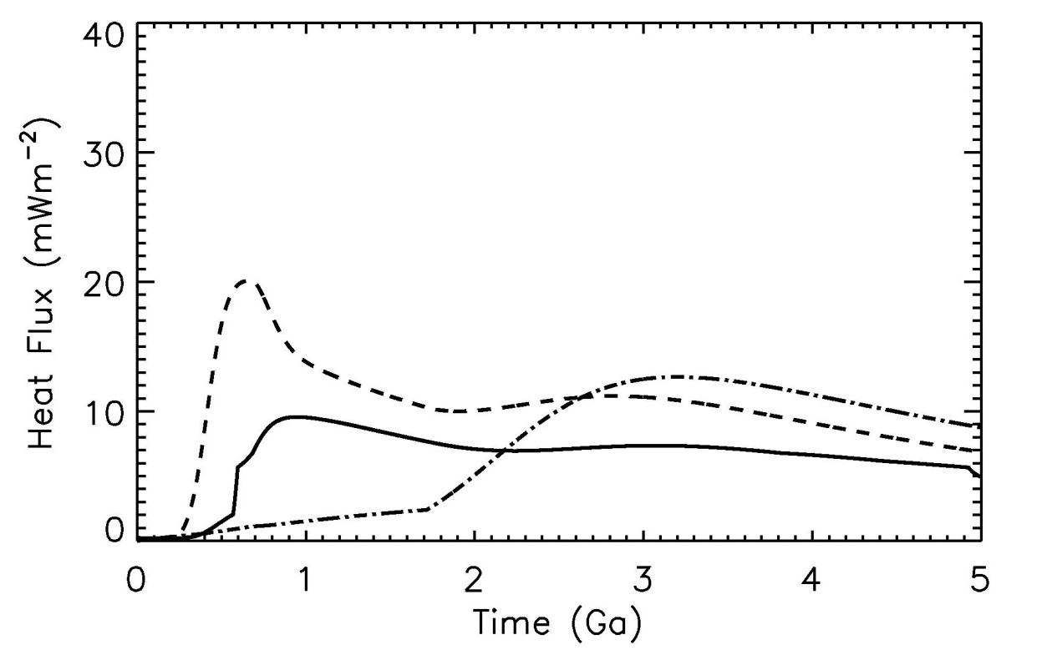
The Nominal Model
Silicate temperatures should be buffered by dehydration
Ice temperatures buffered by melting
Silicate
Mixed Layer
Ice
Onset of convection
Current heat fluxes: ∼6 mW m⁻²
Maximum flux: ∼9 mW m⁻²

Slide 8
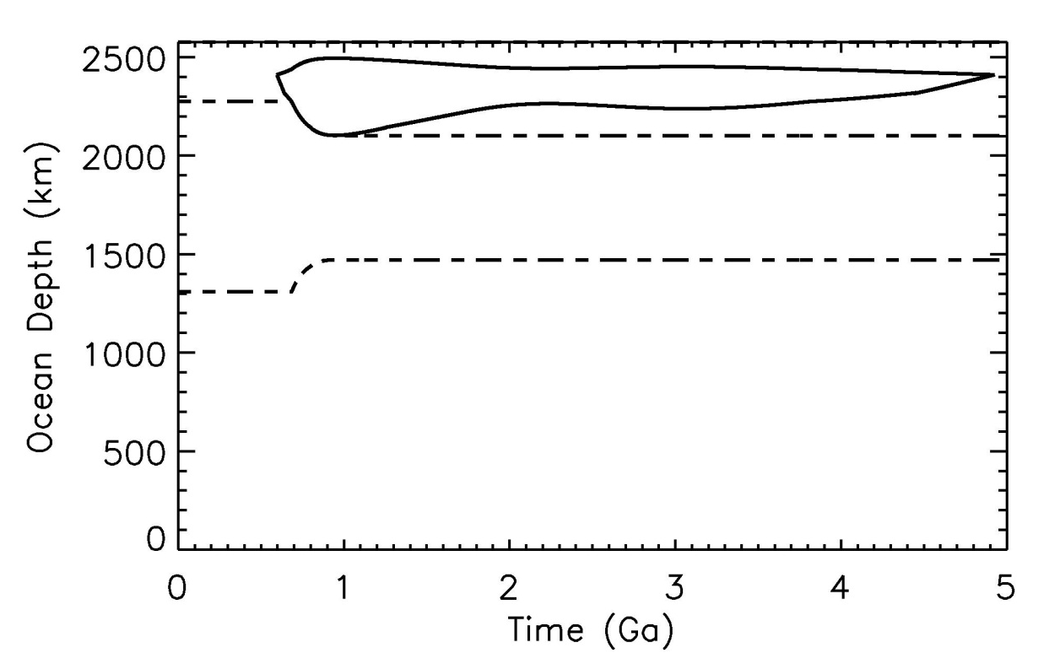

The Nominal Model
73 km thick ocean at 157 km depth
Melting occurs in the mixed ice-rock layer
Radius (km)
Liberated silicate added to core
Un-mixing of mixed rock layer
Final moment of inertia is too low (C/MR² = 0.32)

Slide 9


An alternative Model
R_{c} = 1500 km
R_{mixed} = 2200 km
Increased core size, and decreased the mixed-layer size
Silicate
Mixed Layer
Ice
Current heat fluxes: ∼7 mW m⁻²
Maximum flux: ∼9 mW m⁻²

Slide 10
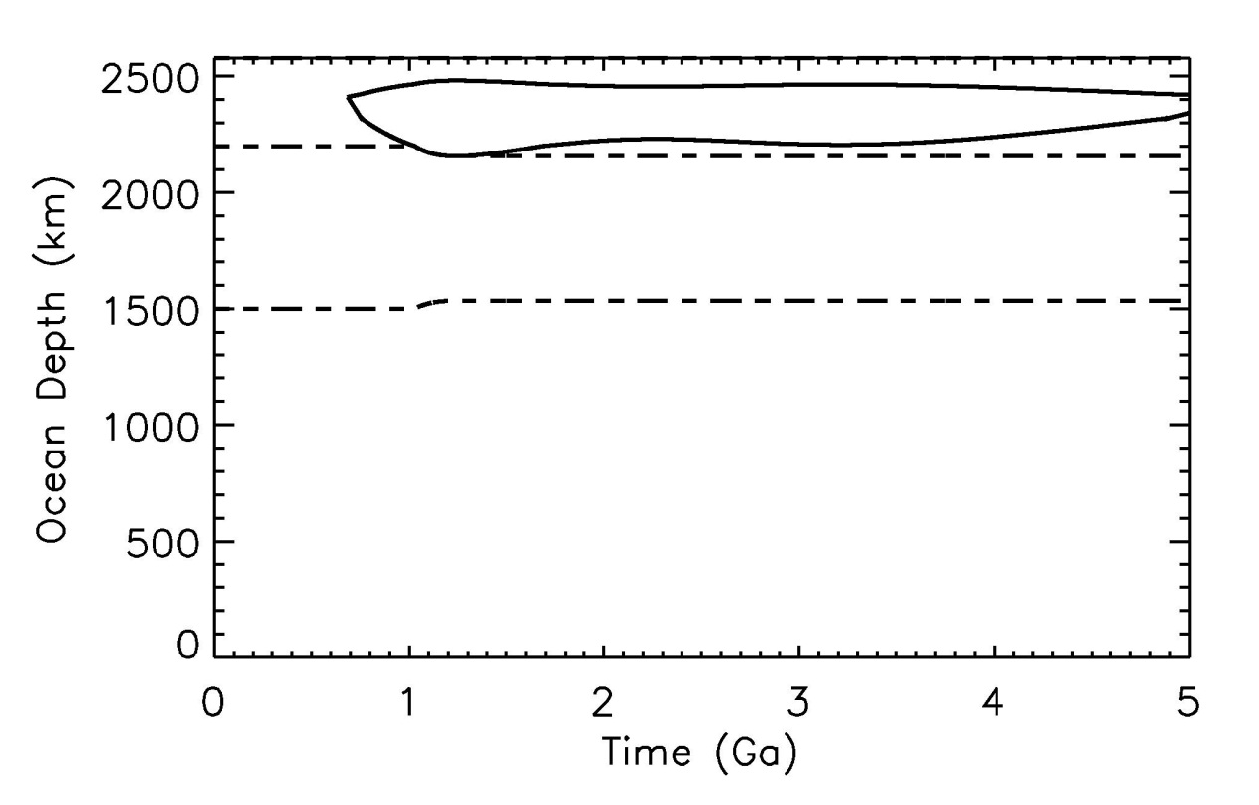

An alternative Model
141 km thick ocean at 143 km depth
Limited melting occurs in the mixed ice-rock layer
Liberated silicate added to core
Less Un-mixing of mixed rock layer
Final moment of inertia:
C/MR² ≈ 0.33

Slide 11
Summary
Three layer models including mixed ice-rock layers are consistent with Titan’s moment of inertia and mean density.
Preliminary modeling indicates that many data-constrained three-layer internal structures are not thermally stable.
These models undergo further differentiation resulting in C/MR² lower than Cassini gravity estimates (∼0.34).
Thermally stable three-layer models do exist and result in C/MR² ∼ 0.33, the lower bound set by Iess et al. 2010.
A large parameter space remains to be explored.
Incorporating chemical processes (dehydration, ocean and ice shell composition - ammonia, etc.) is the next immediate step.

